Slide 1
Introduction to Diabolo Networks*
Krzysztof Kolasiński, 27.06.2017

Slide 2
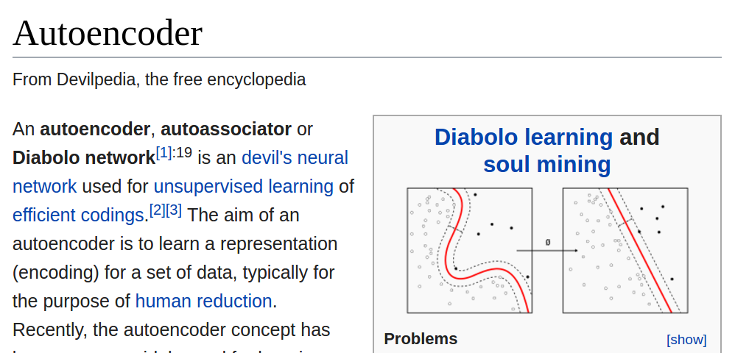
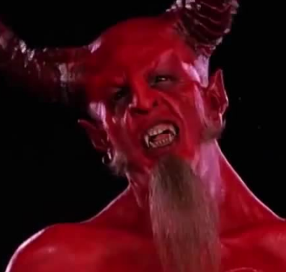
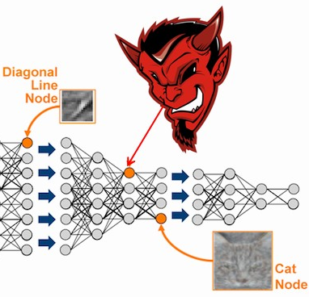
*

Slide 3
Disclaimer
possible lack of knowledge in variational inference and Bayesian stuff - this is quite broad topic in probabilistic modeling
if you know this things already don’t waste your time with me :)
possible errors in the equations,
possible errors in naming stuff
sorry for random over simplification of notation
rare changes in notation (copy-paste effect)

Slide 4
Content
Introduction and motivation for probabilistic modeling
Long derivation of VAEs loss function
Examples

Slide 5
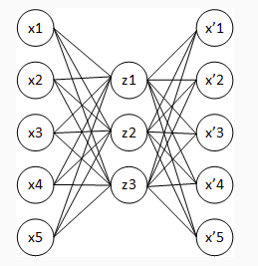
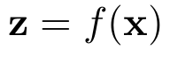
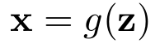
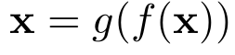
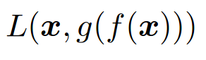
What is an autoencoder?
“An autoencoder is a neural network that is trained to attempt to copy its input to its output”
encoder
decoder
reconstruction equation
We define a general loss:
We want to compress high dimensional data in low dimensional space z (latent space) - manifold learning
AE are problem and data specific (denoising images)
AE are lossy :(
AE are not so very useful :( -> denoising

Slide 6
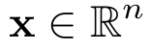
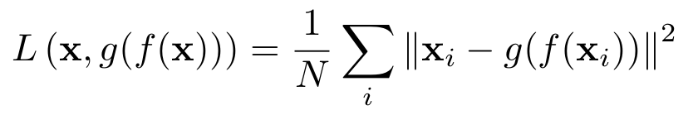
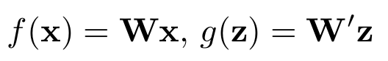
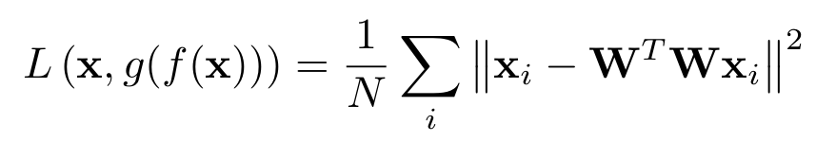
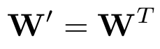
What is an autoencoder?
A toy example: linear auto encoder
Let x be a n dimensional vector
We are going to use quadratic loss function:
We define f and g to be linear projection to low dimensional spaces
with loss
This is definition of PCA in terms of minimizing of reconstruction error
With NNs we can add nonlinearity to improve expressive power of our latent representation

Slide 7
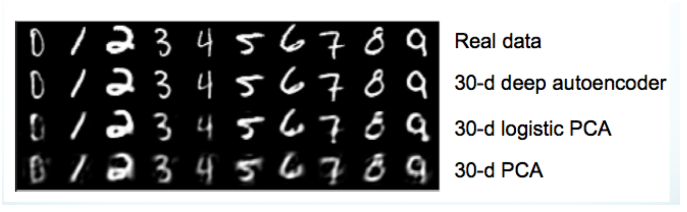
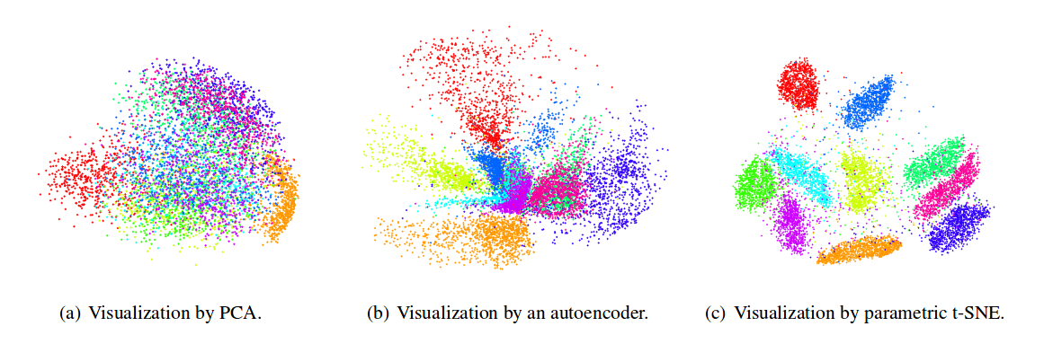
What is wrong with autoencoder?
At first sight it may look promising, but we want to learn meaningful representation of data
But devil is in the details ???

Slide 8
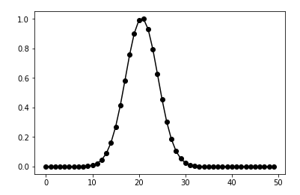
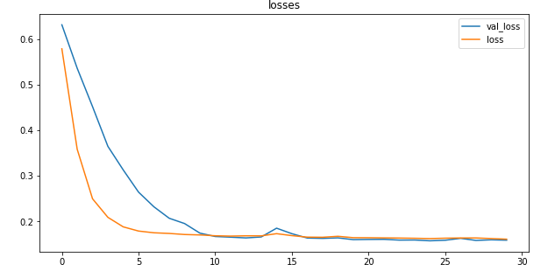
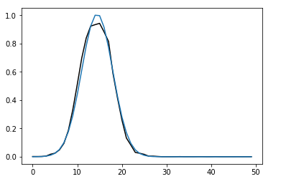
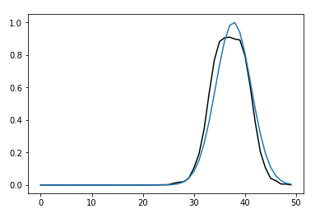
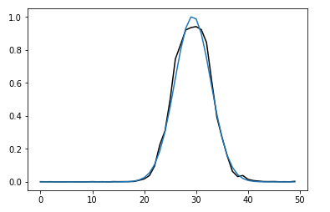
What is wrong with autoencoder?
Another toy model: gaussian controlled by one hidden parameter - position of center
However in practice in practice we don’t know what is the size of latent space. I chose z dimensionality to be 2
I’ve trained simple NN autoencoder:
x
And obtained reasonable reconstructions
Definitely AE got the concept of gaussian
But devil is in the details ???

Slide 9
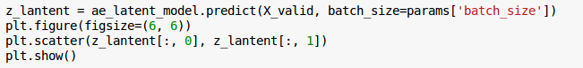
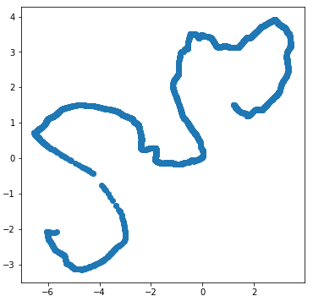
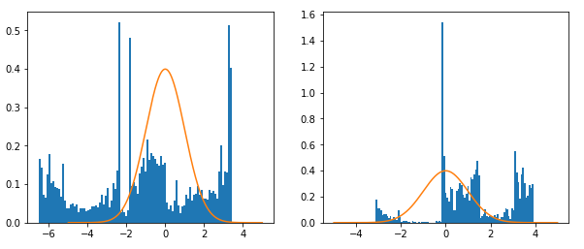
What is wrong with autoencoder?
Let’s plot the manifold!
X_valid
the “manifold”
z₂
x
?
z₁
z₂
z₁
what is here???
No reasonable structure

Slide 10
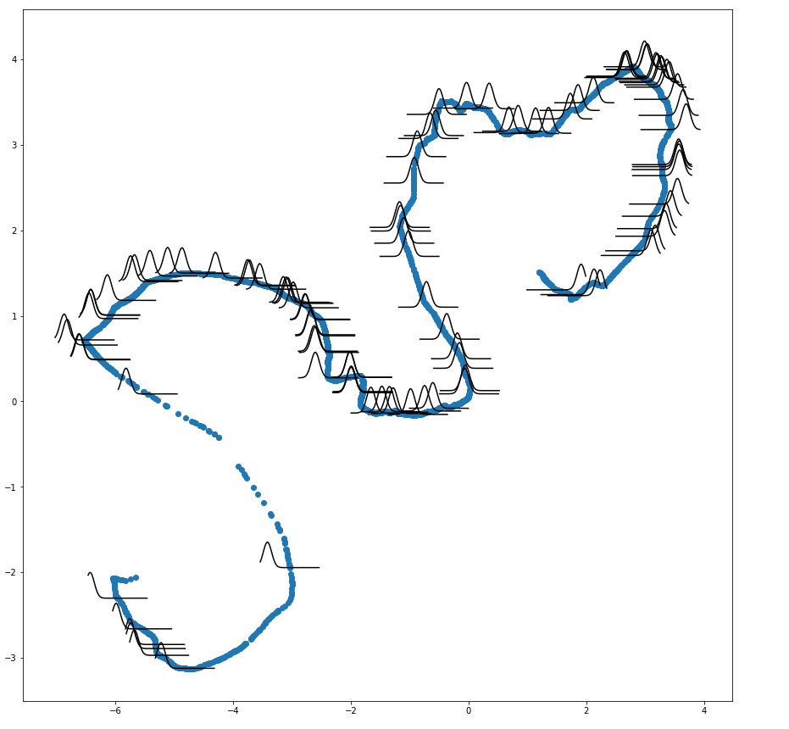
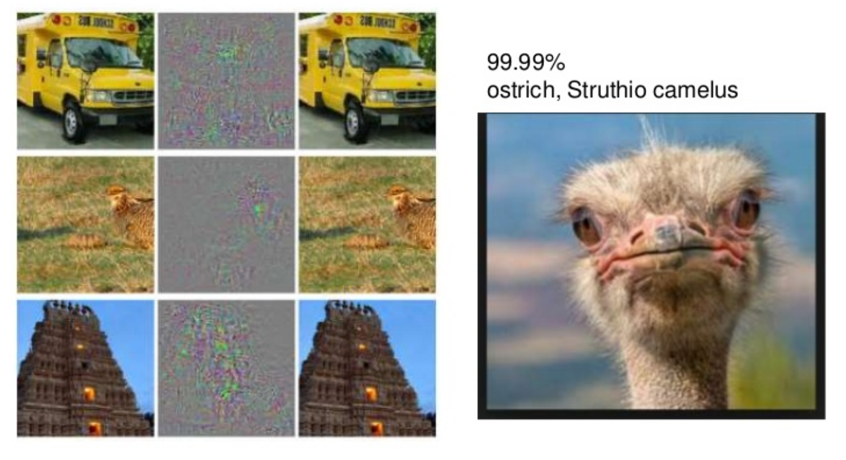
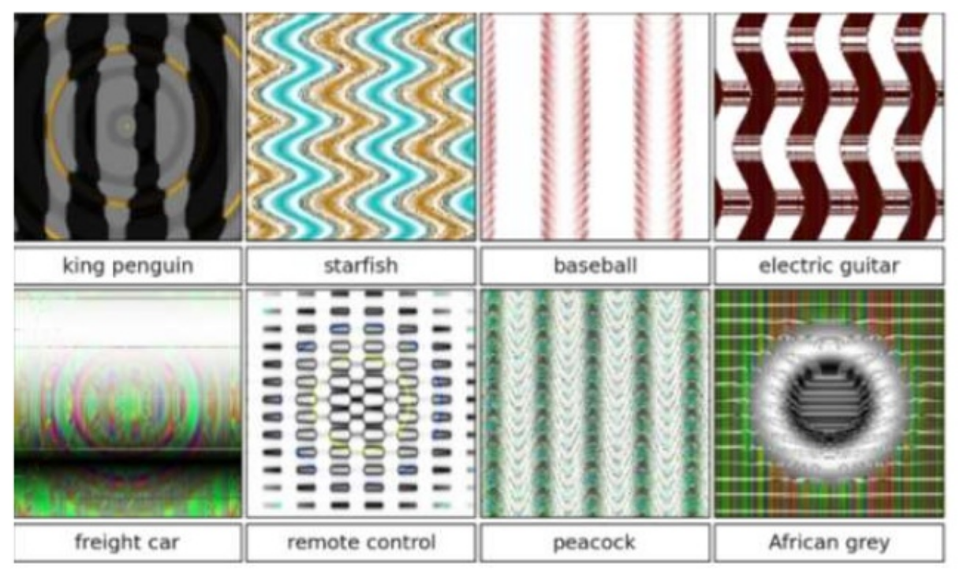
What is wrong with autoencoder?
Let’s plot the manifold!
AE are not “learning efficient representation of our data”!!!, they just cheat to minimize the loss.
The pattern is completely random (depends on initial conditions)
Just avoid simple autoencoders like this
What are the consequences of such behaviour???
Adversarial examples (the need of probabilistic models)
the distances in z space do not preserve real relations

Slide 11
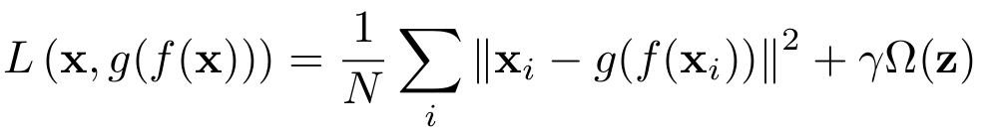
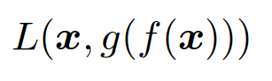
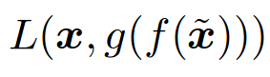
How we can fix this problem?
The problem can be partially solved with regularization techniques
sparse AEs - apply regularization Omega on z activations which encourage the model to learn sparse representations of hidden/latent states
Consider our 1D gauss example this would help the model to completely neglect on of the unnecessary dimensions of the problem. With this regularization we define our preference on values of z
denoising AEs - force AE to learn the structure of your data by minimizing the reconstruction error of corrupted data. This task is harder hence model can learn more usefull features.
From wikipedia: “The higher level representations are relatively stable and robust to the corruption of the input”

Slide 12
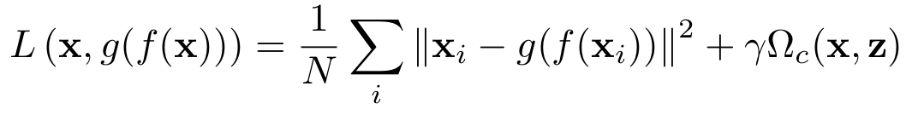
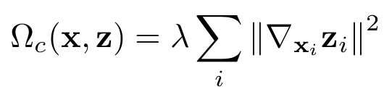
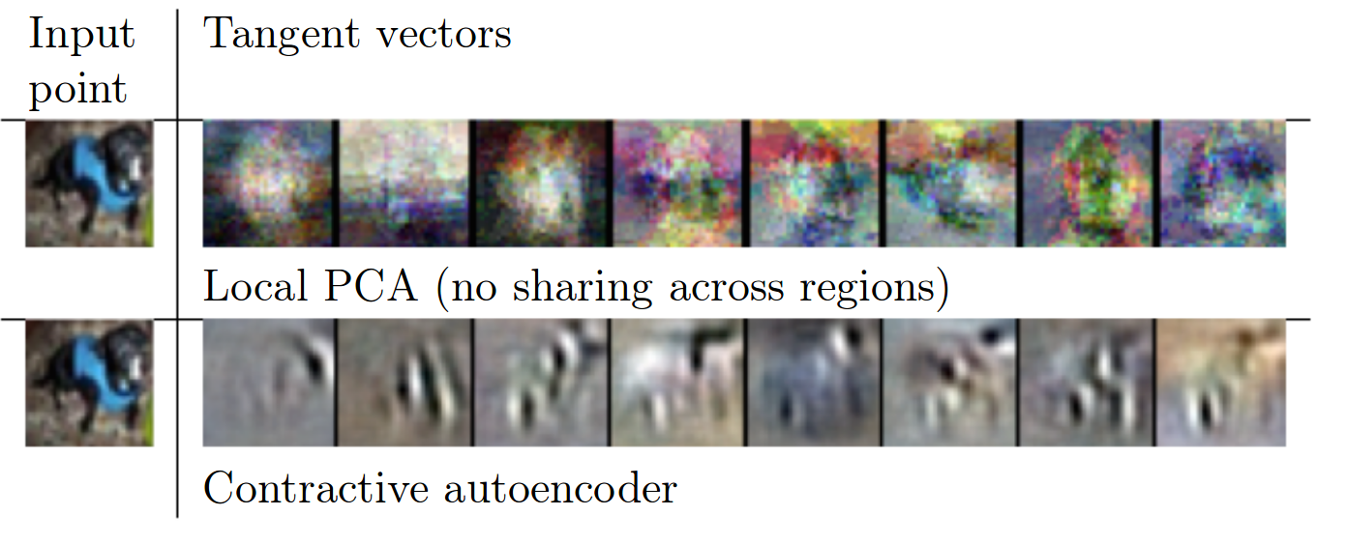
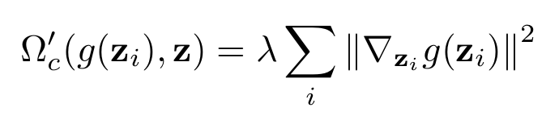
How we can fix this problem?
The problem can be partially solved with regularization techniques
Contractive autoencoder (CAE) - This forces the model to learn a function that does not change much when x changes slightly
The norm is arbitrarily chosen
Another possible regularization not mentioned in literature

Slide 13
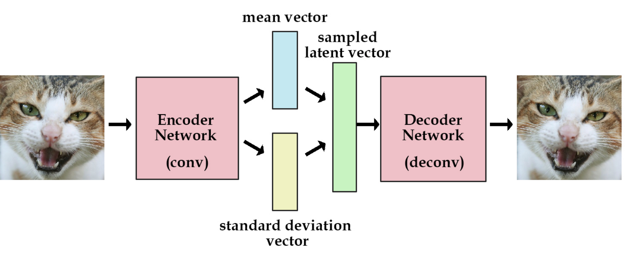
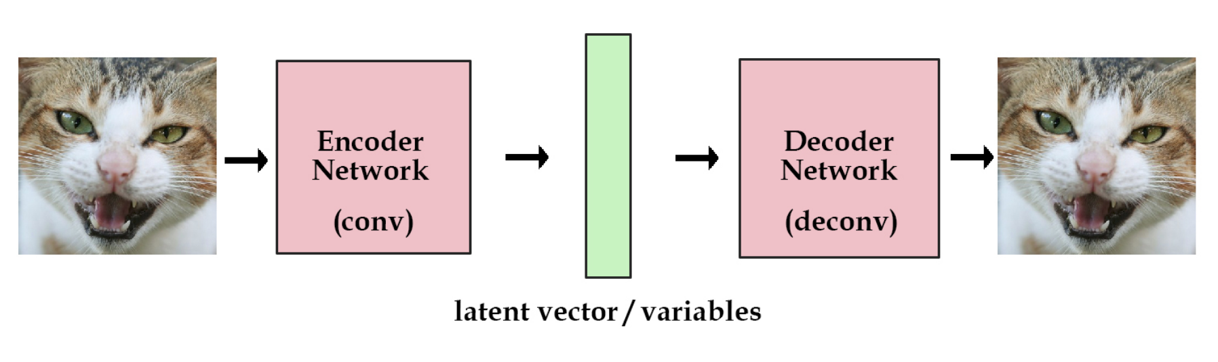
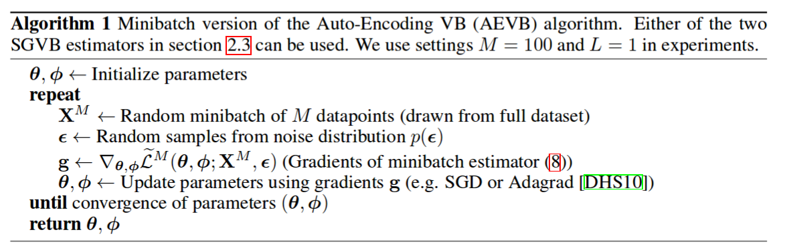
Variational autoencoder principles
The problem can be partially solved with regularization techniques
Variational Autoencoders (VAEs) - “Variational autoencoder models inherit autoencoder architecture, but make strong assumptions concerning the distribution of latent variables”
standard autoencoder
variational autoencoder
Algorithm from original paper:
Auto encoding variational Bayes

Slide 14
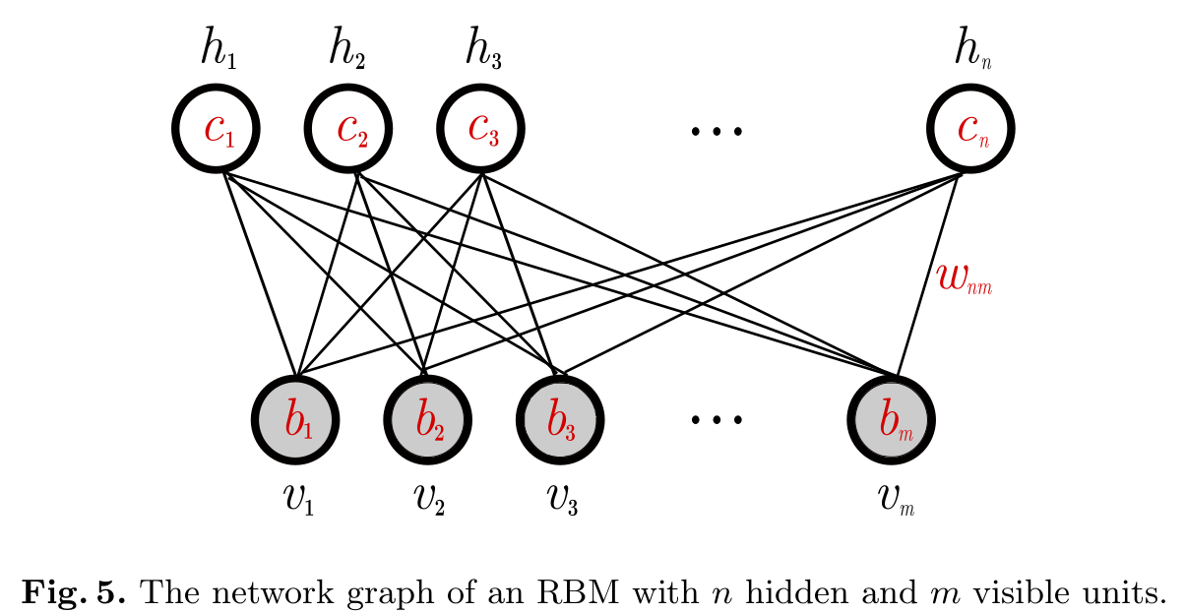
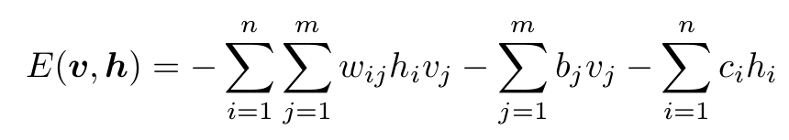
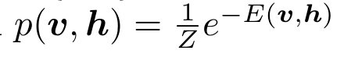
Variational autoencoder principles
The problem can be partially solved with regularization techniques
Variational Autoencoders (VAEs) - “Variational autoencoder models inherit autoencoder architecture, but make strong assumptions concerning the distribution of latent variables”
Some comments before we go into details:
VAEs are generative models, they allow for creation of new samples by sampling from certain distribution.
VAEs are probabilistic models,
VAEs are build on latent space models (like RBMs!)
VAEs are build on top of Variational Inference (VI) theory

Slide 15
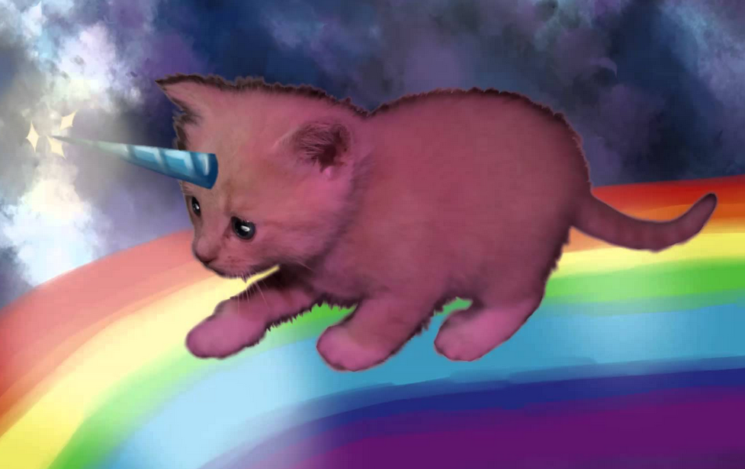
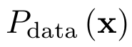
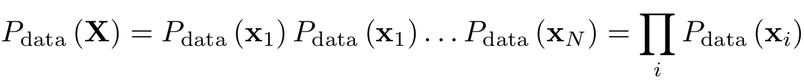
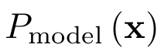
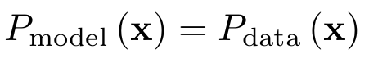
A story about probabilistic models
Assumptions and definitions:
probability of observing data point x (unknown):
samples drawn from p_{data} are independent (like images, CIFAR, MNIST)
we want to create a model from which we can sample:
(variational inference)
in order to build as much “realistic” model as we can we want to have:
this allows us to define target metric which tells us how far from true distribution we are:

Slide 16
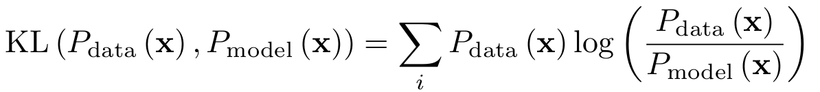
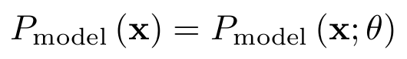
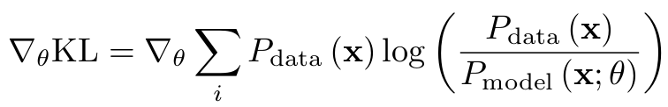
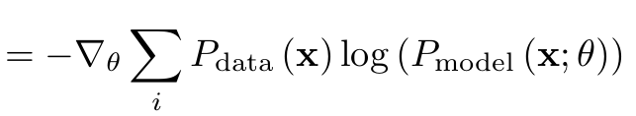
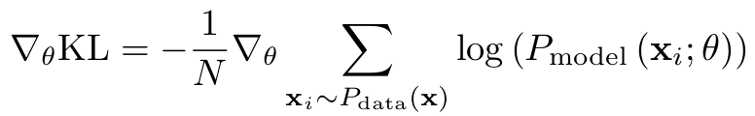
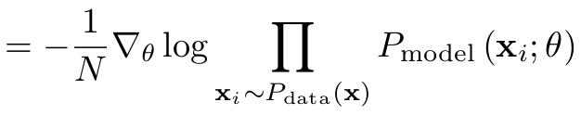
A story about probabilistic models
Assumptions and definitions:
The natural choice for D is Kullback Leibler divergence (this is a critical point for all derivations below):
Our generator P_{model} will be defined by some neural network, let’s put explicitly its dependence on some parameters (neural network weights)
We want to minimize KL w.r.t model parameters, hence we need to compute the gradients
The samples are explicitly sampled from data distribution (N goes to infinity):

Slide 17



A story about probabilistic models
The samples are explicitly sampled from data distribution (N goes to infinity):
Recall assumption that:
This allows us to write similar expression for model (but X are drawn from “real” data)
Hence by minimizing KL divergence we maximize log-likelihood of observed data, both can be used to obtain same result. However with one it maybe do in easier way.
minimize
maximize
example: X - come from gaussian process. We can easily derive proper estimators for mean and variance, which maximize the equation above

Slide 18

A latent variable model
The fact: we want to maximize log-likelihood of observed data
decoder/generator:
Recall our autoencoder: encoder:
The latent variable models assume that there are some latent variables which behaviour may explain data in much easier way.

Slide 19





A latent variable model
The fact: we want to maximize log-likelihood of observed data
We can define new probability which explicitly depends on some latent representation (per one sample x):
the so-called prior on z (the form is assumed by us)
remove the clutter
probabilistic chain rule
generator/decoder conditioned on z
To obtain the P(x) we marginalize it w.r.t latent variable z
Let’s back to our target - maximize log-likelihood of observed data

Slide 20





A latent variable model - a toy example
We need to find maximum of following equation:
Let’s check the above with quite simple toy example:
The data samples
We assume gaussian prior over latent variables (note 2D problem)
The output distribution (variational) - where sigma is some small number (later explained why)
The generator network -

Slide 21





A latent variable model - a toy example
Our loss:
simulation parameters:
We have created model and we can sample from it
optimal value

Slide 22





A latent variable model - a toy example
The effect of number of samples on reconstructed p(x) probability: 100, 1000, 10000
≈
N_{s}=100
N_{s}=1000
N_{s}=10000
P_{model}(x) reconstructions for cross-section y=0
Ok, but why this strange form of the output distribution works???

Slide 23




A latent variable model - a toy example
Ok, but why this strange form of the output distribution works???
Consider following super simple toy example: (remember we want P_{model}=P_{data})
The integral can be performed analytically:
Equals to P_{data} when Theta=Beta and sigma = 0 !!!
When we are doing sampling we have to choose sigma, which may lead to blurred out distributions when sigma is too large

Slide 24


A latent variable model - a toy example
Ok, but why this strange form of the output distribution works???
Consider following general case and sigma approaching zero
definition of Dirac delta distribution
find z’ which satisfies this equation i.e. generator remaps from gaussian prior to arbitrary P(x)
We already have seen such mapping in our toy example:
Consider NN as complicated nonlinear function which can learn arbitrarily complex distribution

Slide 25

The importance of encoder network
We need to find maximum of following equation:
What are the potential problems with the equation above???
Recall previous page: sigma has to be very small, hence sampling is very hard since most of the “hits” will give zero contribution
We would like to decrease the “rejection” ratio somehow

Slide 26




The importance of encoder network
We need to find maximum of following equation:
Consider following steps
back to sum over uniformly distributed z
we introduce auxiliary distribution Q (encoder)
sample from Q instead of P(z) - importance sampling
The role of the Q is to provide most probable values of z based on x

Slide 27




The importance of encoder network
Q is the encoder network:
Consider that network learned following Q function (Bayes theorem)
we would really like to learn something like this!
Then we get:
In this ideal scenario we do not even have to sampling since Q is doing all the work of us
which is the maximal value of L! Neural net ?can? by chance learn something like this

Slide 28




The final derivation of the VAE loss function
The original expression is hard to compute
The standard approach is to approximate the above with its lower bound ELBO
This is a general property of concave functions called Jensen’s inequality
Nice property, when:
we recover accurate value of L (recall last slide)
The end!

Slide 29




The final derivation of the VAE loss function
The final expression for the VAE loss is then
For simplicity the encoder network is assumed to be … another gaussian
is constrained to be diagonal matrix
are implemented by NN
Since Q and P are Gaussians there is a closed formula for KL divergence:
spend a moment here to understand this
ref paper

Slide 30
The final derivation of the VAE loss function
The final expression for the VAE loss is
Usually we set number of samples to 1...
Measures the reconstruction error
This is correct when Q can be modelled with gaussian
Can be interpreted as regularization to autoencoder

Slide 31



The VAE diagram and reparametrization trick
Sample random number
reparametrization trick
Cannot compute gradients here: stochastic layer
Provide stochastic input, then the output of the layer is deterministic and gradient can be computed

Slide 32
Remember this?
Let’s plot the manifold for AE!
AE are not “learning efficient representation of our data”!!!, they just cheat to minimize the loss.
The pattern is completely random (depends on initial conditions)
Just avoid simple autoencoders like this
What are the consequences of such behaviour???
Adversarial examples
the distances in z space do not preserve real relations

Slide 33

Remember this?
AE latent space
VAE latent space
Note, that here the concept of one dimensionality of the problem is well captured
We wanted Q to be gaussian N(0,1)

Slide 34



VAE vs AE
AE latent space histograms
VAE latent space histogram
z₁
z₂
z₁
z₂
Let’s take a look into Mean and Sigma outputs activations
the concept is here
not active
keeps sigma one to minimize KL
μ₁
μ₂
Σ₁
Σ₂

Slide 35





The effect of the KL regularization
If the KL term will be too strong then the model will try to make Q = N(0,1)
We have competition between reconstruction quality and proper distribution of activations
On the other hand if this term is too weak model will converge to simple AE (with sigma=0)

Slide 36


VAE as a generative model
Q is a simple Gaussian, hence we can easily sample from it to generate similar samples to input one
Or we can directly sample from N(0,1)
Demo: Digit Fantasies by a Deep Generative Model

Slide 37


VAE as a generative model - MNIST example
Latent space
Generated images

Slide 38



Summary
minimize the distance w.r.t params
maximize
variational inference
latent variable model
sampling from encoder distribution instead of P(z)
Jensen’s inequality
VAE loss

Slide 39
Discussion and overview of recent results
Are there some questions?

Slide 40


Conditional VAEs
Add additional information/labels to your model to force conditional behaviour of the model
Some potential applications:
hole filling
class dependent object generation
Diagram of CVAE
reference

Slide 41





Importance weighted autoencoders (Nov 2016)
Sorry for the change in notation
The VAE loss for one example x
arxiv:1704.02916
in our notation
Instead approximate the loss from direct expression:
we obtained VAE by simplifying it using Jensen’s inequality
The difference is visible once we compute gradients
VAE is evenly weighted but IWAE uses importance of each sample

Slide 42



Importance weighted autoencoders (Nov 2016)
Comparison between VAE and IWAE
blue true posterior, red reconstructions
A nice thing to have:

Slide 43


Adversarial Autoencoders (May 2016)
Combine VAE and GANs
“The bottom row diagrams a second network
trained to discriminatively predict whether
a sample arises from the hidden code of the
autoencoder or from a sampled distribution
specified by the user”
Lack of technical details in the paper

Slide 44


Adversarial Autoencoders (May 2016)
Same as above but add labels into encoder
“Regularizing the hidden code by providing a one-hot
vector to the discriminative network. The one-hot
vector has an extra label for training points
with unknown classes.”

Slide 45


Adversarial Autoencoders (May 2016)
Disentangling style from content
“Disentangling the label information from the
hidden code by providing the one-hot vector
to the generative model. The hidden code in
this case learns to represent the style of the image.”

Slide 46


Adversarial Autoencoders (May 2016)
Dimensionality Reduction with Adversarial Autoencoder
They found Batch Normalization to be crucial in AAE clustering experiments.

Slide 47

Discriminative Regularization for Generative Models
Recall our VAE loss
Missing high frequency information: caused mainly by L2 regularization (problem of comparison between translated images)
Missing semantic information: generative models of natural images often lack a clear sense of “objectness”.

Slide 48

Discriminative Regularization for Generative Models
match the reconstructed image within representation space

Slide 49


Discriminative Regularization for Generative Models

Slide 50


Autoencoding beyond pixels using a learned similarity metric (2016)
Combine GANs with VAEs - similar idea (Feb 2016)

Slide 51

Autoencoding beyond pixels using a learned similarity metric (2016)
Combine GANs with VAEs - similar idea (Feb 2016)
source

Slide 52

Autoencoding beyond pixels using a learned similarity metric (2016)
Combine GANs with VAEs - similar idea (Feb 2016)
source

Slide 53


Semantic Facial Expression Editing using Autoencoded Flow
(Nov 2016)
use VAEs to encode the picture of face into low dimensional latent space
standard method leads to blurred images
instead use methods like patched matching - reconstruct image from existing part of images
combine CNN with optical flow - don’t reconstruct RGB pixels but how they move
A Flow VAE
For more technical details see paper

Slide 54

Semantic Facial Expression Editing using Autoencoded Flow
(Nov 2016)

Slide 55

Semantic Facial Expression Editing using Autoencoded Flow
(Nov 2016)

Slide 56
Questions?

Slide 57
References
http://slazebni.cs.illinois.edu/spring17/lec12_vae.pdf - well detailed presentation about VAEs, highly recommended
http://kvfrans.com/variational-autoencoders-explained/ - some blog post, but nothing special. Maybe it is worth to take a look on it, since it may provide some intuitions
https://arxiv.org/abs/1606.05908 - Tutorial about VAEs probably most complete
https://jaan.io/what-is-variational-autoencoder-vae-tutorial/ - interesting Bayesian interpretation of VAEs - a blog post
http://wiseodd.github.io/techblog/2016/12/10/variational-autoencoder/ - another blog post, well written with math and keras implementation
http://www.cs.toronto.edu/~duvenaud/courses/csc2541/ - online course about variational inference

Slide 58
References
http://www.cs.toronto.edu/~duvenaud/courses/csc2541/slides/lec2-vae.pdf - page 11 - a short derivation of ELBO variational loss
https://arxiv.org/pdf/1509.00519.pdf - paper about importance sampling in VAEs
https://arxiv.org/pdf/1704.02916.pdf - a workshop material about importance sampling, really nice interpretation of the above paper - highly recommended
http://www.cs.toronto.edu/~duvenaud/courses/csc2541/slides/structured-encoders-decoders.pdf - page 16 - VAE problems, page 28 - importance sampling, 44 - the role of the sampling - this is actually summary of IWAE paper

Slide 59
References
http://www.cs.toronto.edu/~duvenaud/courses/csc2541/slides/structured-encoders-decoders.pdf - DRAW method - not discussed during presentation, VAE plus attention
https://www.slideshare.net/ShaiHarel/variational-autoencoder-talk - a nice motivation for VAEs in terms of adversarial examples
http://www.dpkingma.com/sgvb_mnist_demo/demo.html - animations with reconstructions
http://dpkingma.com/?page_id=393 - a complete list of different implementations of VAEs
http://blog.shakirm.com/2015/03/a-statistical-view-of-deep-learning-ii-auto-encoders-and-free-energy/ - not covered during presentation - the relation between autoencoders and free energy
http://orbit.dtu.dk/files/121765928/1602.02282.pdf - not covered in the presentation - a paper about different experiments how to train VAEs - with BN and Relus - probably not rocket science

Slide 60
References
https://arxiv.org/pdf/1602.03220.pdf - paper about discrimintative VAE with classifier at the end of the network
http://edwardlib.org/tutorials/klqp - Edward tutorial about ELBO derivation
https://arxiv.org/pdf/1511.05644.pdf - adversarial autoencoder

Slide 61


